Slide 1
Before We Start Make Sure that…
You have taken a recent pull of the Kranti app from git@github.com:androidbootcamp/Kranti-Android-Day-3.git
Kranti app is running properly in your device.

Slide 2
Agenda
Selection Widgets
Adapters
ArrayAdapters
Custom Adapters
Pending Intents (only Demo)

Slide 3
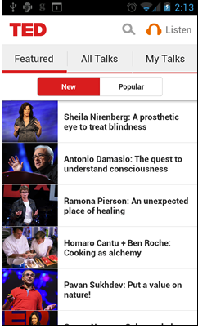
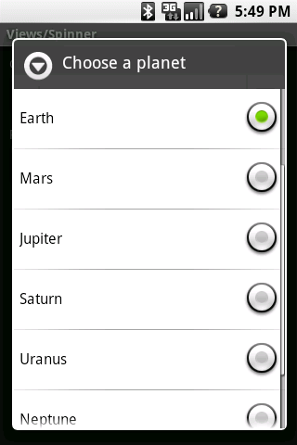
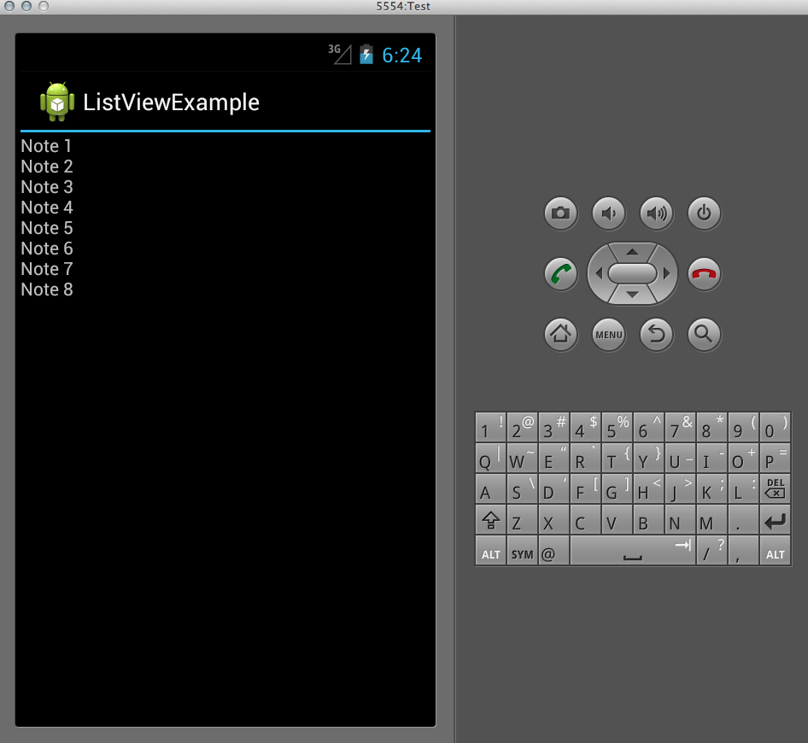
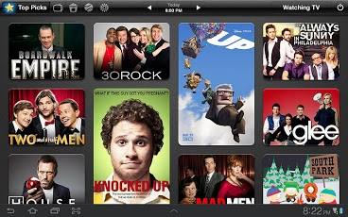
Selection Widgets

Slide 4
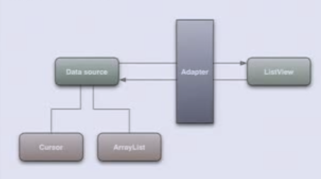
Adapters
What are adapters?
Need
Data Source
Adapter
ListView
Cursor
ArrayList

Slide 5
ArrayAdapter
To use ArrayAdapter
ArrayAdapter<String> adapter = new ArrayAdapter<String>(context,resource ID of a view to use, actual array/list of items);
Steps:
Include ListView in your layout
Invoke setAdapter()
Attach a listener via setOnItemSelectedListener()
Implement the same in Kranti App

Slide 6
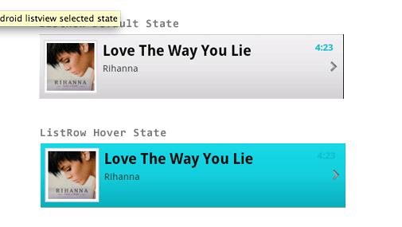
Custom Adapter
Need
Implement a custom adapter in the Kranti App
Understanding
public abstract View getView (int position, View convertView, ViewGroup parent)

Slide 7
Pending Intent
Demo
Understanding
public static PendingIntent getActivity(Context context,int requestCode, Intent intent,int flags

Slide 8
Agenda
Selection Widgets
Adapters
ArrayAdapters
Custom Adapters
Pending Intents (only Demo)

Slide 9
References
http://commonsware.com/Android/excerpt.pdf
http://www.simplecodestuffs.com/what-is-pending-intent-in-android/
http://www.vogella.com/articles/AndroidNotifications/article.html
http://www.androidhive.info/2012/02/android-custom-listview-with-image-and-text/
http://www.nofluffjuststuff.com/blog/vladimir_vivien/2011/09/creating_android_view_adapters_is_easy_but_beware_
http://developer.android.com/reference/android/content/BroadcastReceiver.html

